Slide 1

For Live Session
TS Unit 1
Nicholas Sager

Slide 2
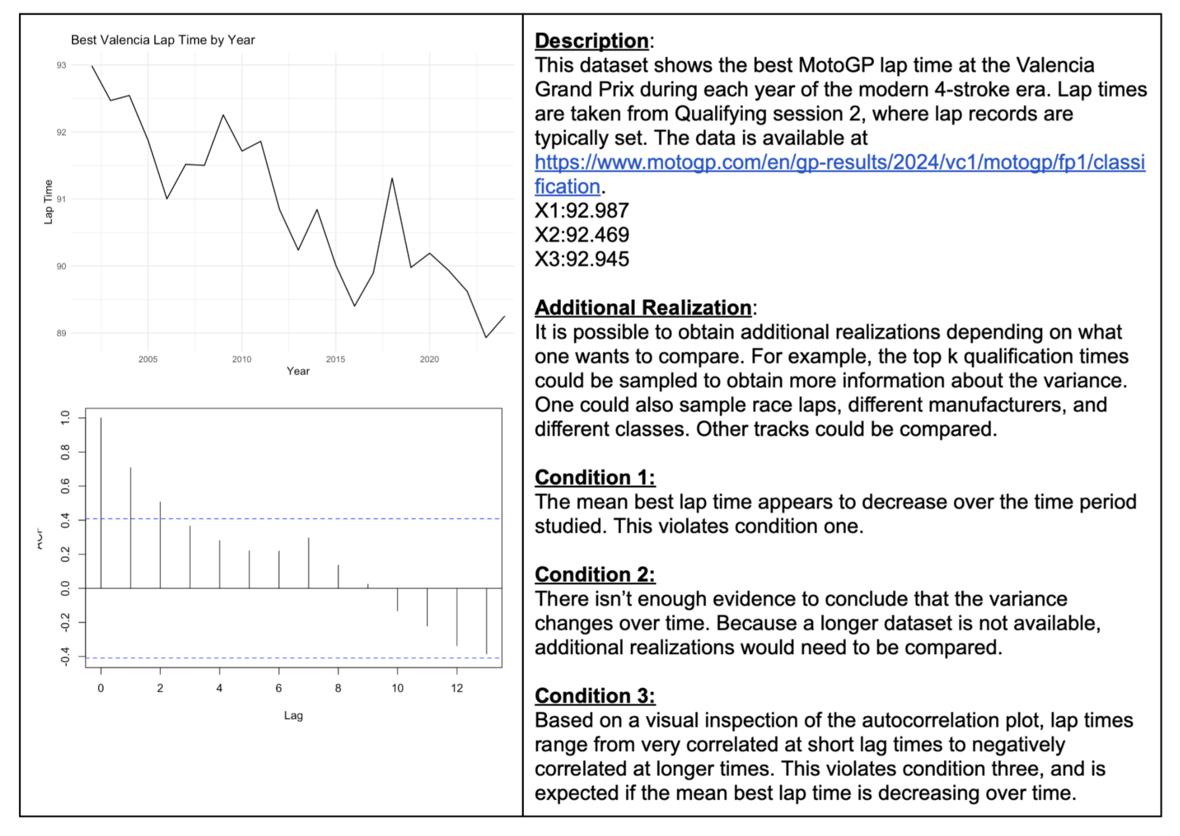
Sample Time Series

Slide 3
Takeaways
Assumptions for Stationary Time Series
Mean constant with time
Variance constant with time
Autocorrelation depends only on lag, not specific value of time
Learning how to use R again.
Question: Can I suppress the numerical output from `plotts.sample.wge`? I didn’t see the option in the documentation.

